Slide 1

Marine Vessel Propulsion System
AIS4004 – Digitale Twins for Predictive Maintenance
Task 1:
Problem Definition
Data Preparation & EDA
Marius, Vetle, Mathias and William
03.02.2026

Slide 2

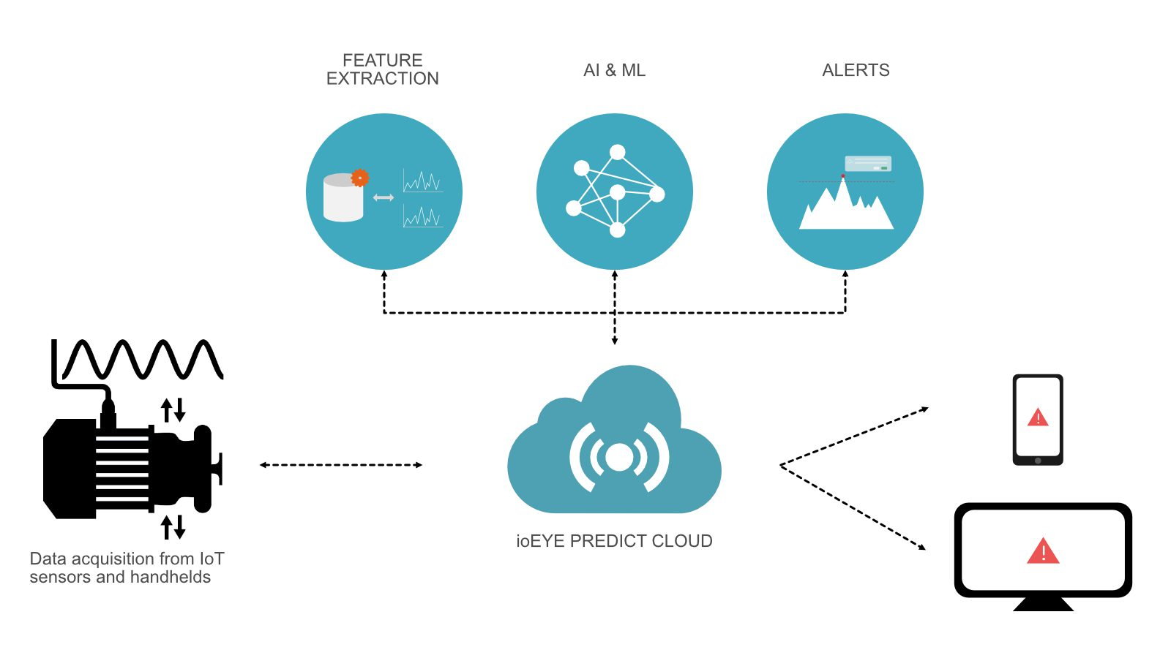
Problem Definition
Use of an AI-Agent to process raw sensor data to able predicative maintenance
Raw data --- clean data ---- Reliable analysis
Predict faults and suggest maintenance schedule
Notes:
We must transform raw marine propulsion sensor data into a clean, consistent dataset that enables reliable analysis and predictive modelling, despite operating-regime effects and potential data-quality issues (missing values, duplicates, inconsistent readings, and outliers).
Develop a data-driven condition monitoring and predictive maintenance approach for a marine vessel propulsion system by using sensor and operating data to estimate the propulsion system’s health/degradation and provide actionable diagnostics/prognostics (early warning, trends, and maintenance-relevant status) under varying operating regimes.

Slide 3
Objectives & Goals
Build predictive model.
Develop reliable condition monitoring workflow
Produce interpretable outputs, that supports maintenance decision.
Clean dataset.
Clear performance.
Monitoring style output.
Concise report.
Notes:
Objectives:
Build a predictive model that maps propulsion-system sensor/operating data to health/degradation indicators (e.g., compressor and turbine decay).
Develop a reliable condition monitoring workflow that works across different operating regimes and is robust to noise/outliers.
Produce interpretable outputs that can support maintenance decisions.
Goals:
A cleaned and documented dataset + EDA that justifies preprocessing choices.
Trained and compared ML models (≥3) with clear performance metrics and a selected “best” model.
A monitoring-style output: predicted health/decay over time, plus anomaly/outlier identification.
A concise report/presentation that explains assumptions, limitations, and how results would be used in practice.

Slide 4
Data visiualization (EDA)
Distributions: histograms + boxplots for key sensors and targets
Relationships: scatter plots for main operating links (load/speed/torque/rpm vs fuel/temps/pressures)
Correlation overview: correlation heatmap to spot strong dependencies and redundancy
Operating regimes: colour/marker by throttle/speed setpoints to separate regimes visually
Notes:
Histograms and boxplots are used to examine the distribution and spread of key sensors and targets, and to identify potential outliers or abnormal values.
Scatter plots allow us to assess the relationship between operating variables and system responses, and to verify that the data reflects expected physical behavior.
The correlation heatmap provides an overview of linear dependencies between variables and helps identify redundancy in the dataset.
By coloring data points according to throttle or speed setpoints, we can visually separate different operating regimes and observe whether relationships remain consistent across operating conditions.

Slide 5
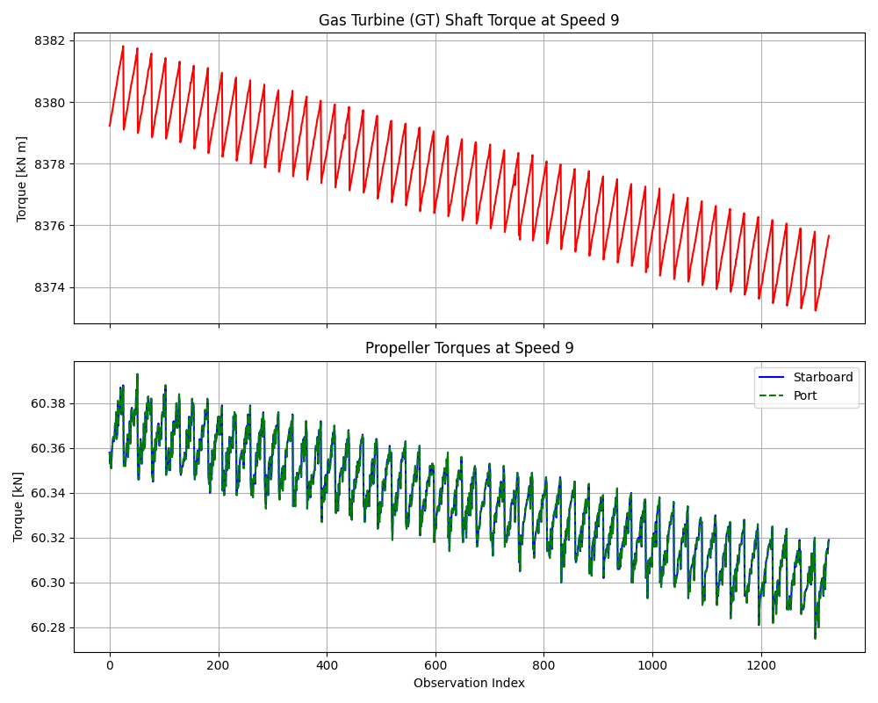
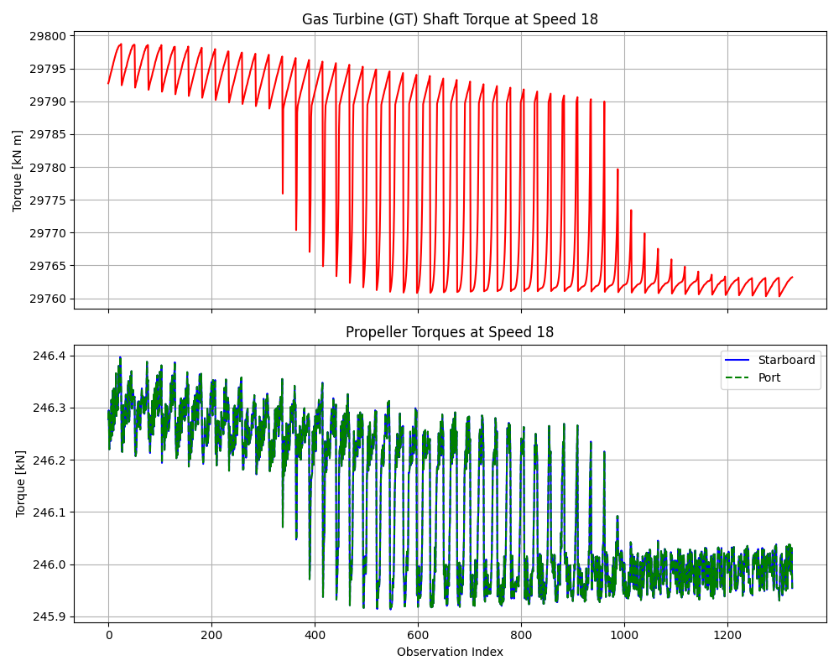
Dataset Preparation
Check dataset for missing values
Dataset is complete with no missing values
Checking for duplicates
No Duplicate values
Ensure data consistency
Consistent number of values (1326 each speed state)
Consistent data structure
Corresponding input/outputs

Slide 6
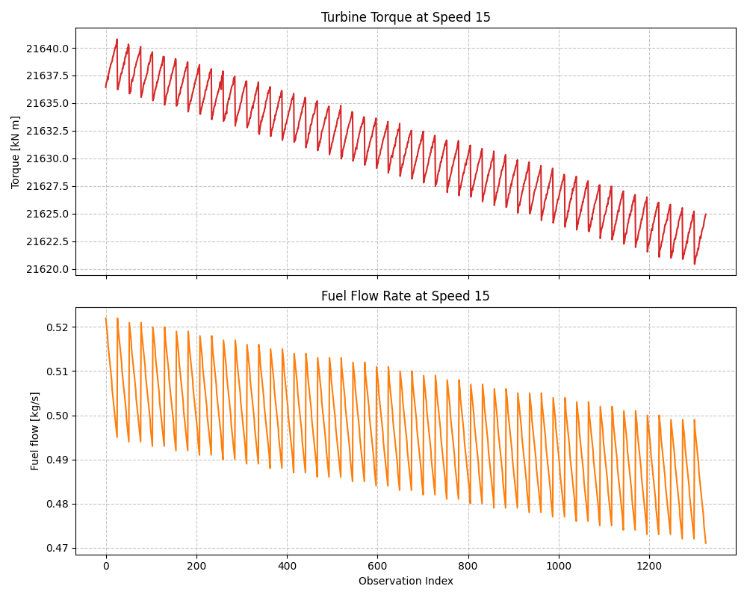
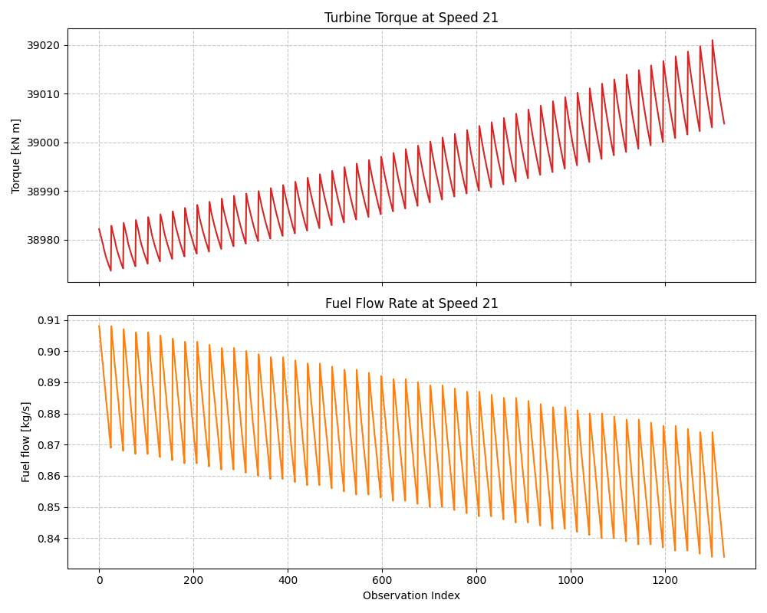
Data Paterns and consistancy
Patterns:
Find corresponding input/outputs
When patterns break
Outliers we look for:
Isolated spikes in single sensors (likely measurement glitches)
Points that break the main trend in scatter plots (abnormal operating points)
Inconsistent paired signals (e.g., port vs starboard where applicable)

